Slide 1
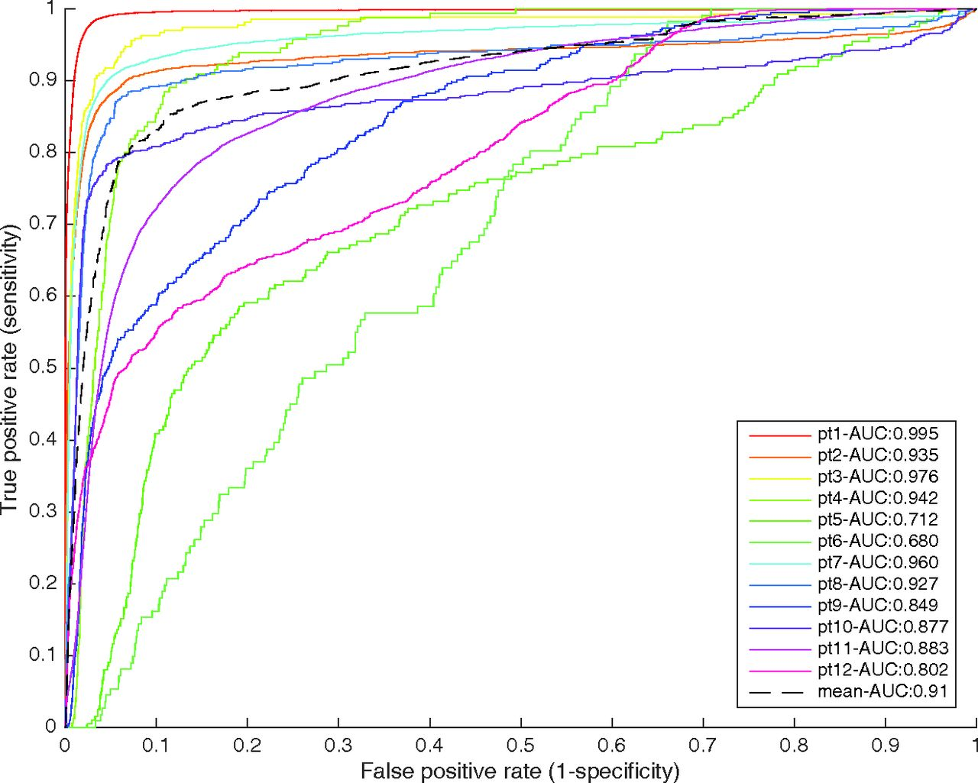

ROC curves from the leave-one-out cross-validation.
T.K. Yanagihara et al. AJNR Am J Neuroradiol 2016;37:2019-2025
©2016 by American Society of Neuroradiology
Notes:
ROC curves from the leave-one-out cross-validation. Each curve and its area were computed by generating a model based on 11 patients and applying it to an individual patient.

