Slide 1
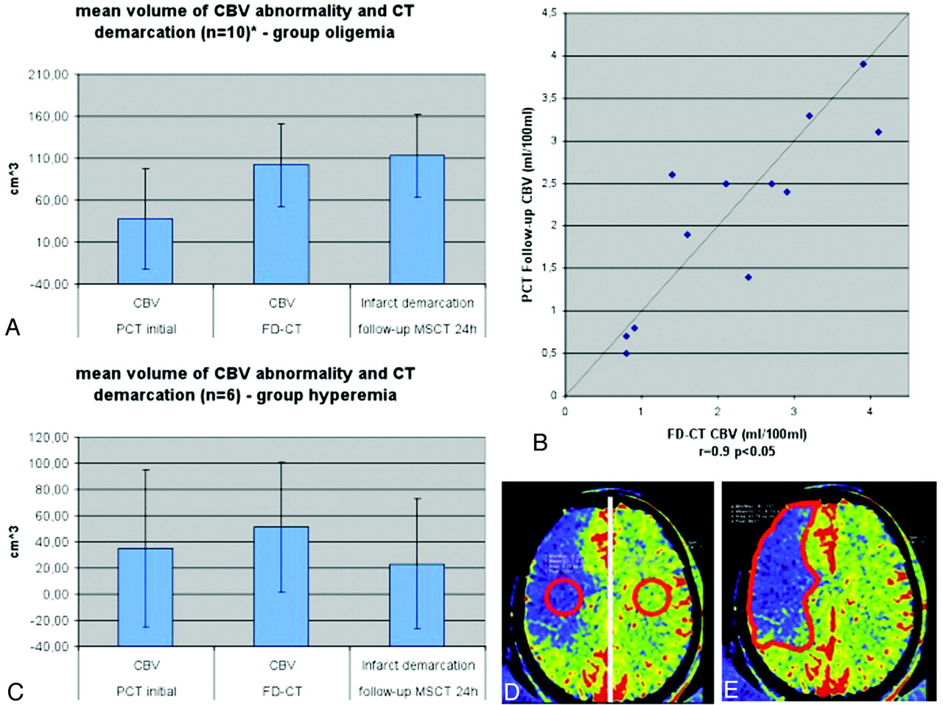

In the oligemia group (A), CBV abnormality volume increased from the initial measurement to the FPCT CBV measurement performed immediately at the end of treatment.
T. Struffert et al. AJNR Am J Neuroradiol 2012;33:618-625
©2012 by American Society of Neuroradiology
Notes:
In the oligemia group (A), CBV abnormality volume increased from the initial measurement to the FPCT CBV measurement performed immediately at the end of treatment. The FPCT CBV abnormality volume was nearly identical to the infarct volume, as determined on the 24-hour follow-up CT. Comparison of CBV values (B) of the oligemia group revealed a high correlation on FPCT and follow-up PCT. In the hyperemia group (C), the abnormality volume increased only slightly, but not significantly, from initial to posttreatment FPCT CBV measurement. Infarct volume was lower than FPCT CBV abnormality volume. Only 2 patients in this group of 6 patients presented with stroke demarcation. (D) The region of interest for measurement of the absolute CBV values is displayed. (E) The region of interest for measurement of the volume is displayed.

